Slide 1
ALGEBRA 4
Day 52

Slide 2
Bell Work What Questions do we want to address before the test?

Slide 3
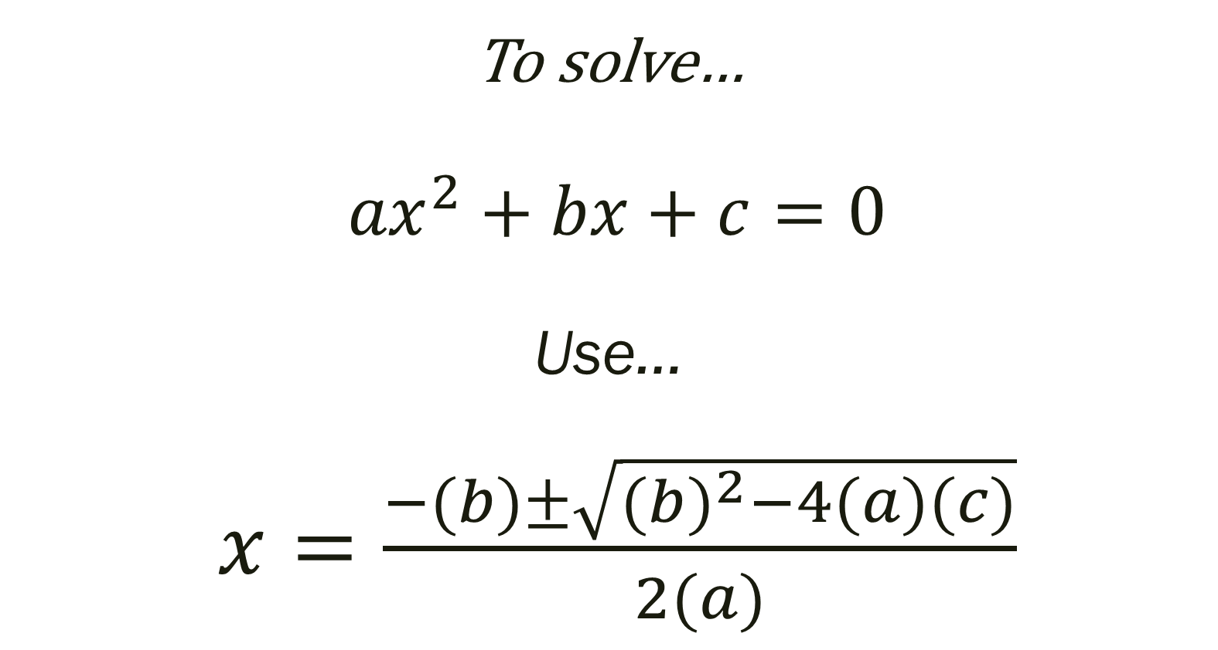
To solve… ${ax}^{2}+bx+c=0$ Use… $x=\frac{−(b)±\sqrt{(b)^{2}−4(a)(c)}}{2(a)}$

Slide 4
Things to Study
Identify Standard Form, Degree, Lead Coefficient, Constant. Etc
Factor (use zeros from graph if necessary)
Write Equation given zeros
Find zeros (from graph and/or with division)
Divide polynomials

Slide 5
Review Assignment
Select the problems that you need the most work on… or we can do some as a class
Page 348 #5-29, 35-37, 44-47, 52-53, 60-67
Your other option is to work problems from missing assignments

